Slide 1
1.3 Data storage and compression
Understand how data storage is measured
Calculate the file size of an image file and a sound file, using information given
Understand the purpose of and need for data compression
Understand how files are compressed using lossy and lossless compression methods
Lossless compression reduces the file size without permanent loss of data, e.g. run length encoding (RLE)

Slide 2
Today
Understand how data storage is measured
Calculate the file size of an image file and a sound file, using information given
Understand the purpose of and need for data compression
Understand: Different ways to represent data
Able: Perform RLE
Answer: What is the difference between lossy and lossless

Slide 3
Remember when we did this…..
1 bit = 1 binary digit = the smallest thing you can have
1 byte = 8 bits
1 kilobyte = 1024 bytes
1 megabyte = 1024 kilobytes
1 gigabyte = 1024 megabytes
…
Bit > Byte > Kilobyte > Megabyte > Gigabyte > Terabyte > Petabytes > Exabyte > Zettabyte > Yottabytes > Brontobyte > Geopbyte

Slide 4
Well there is a problem….
Question: How many meters are in a kilometre (km)?
Answer: 1000
Question: How many grams are in a kilogram (kg)?
Answer: 1000
So why is kilobyte 1024 and not 1000?
Okay….. This next part is nonsense, but stay with me….
Cambridge wants us to use some new words. These new words were made by the IEC, International Electrotechnical Commission
And no one….no one….no one uses these new words, but we need to do them because Cambridge says so

Slide 5
ICE Sizes
The IEC wants to keep everything as 1000 not 1024. So it goes:
1 bit
1 nibble = 4 bits
1 byte = 2 nibbles = 8 bits
1 kilobyte (kb) = 1000 bytes
1 megabyte (mb) = 1000 kb
1 gigabyte (gb) = 1000 mb
1 terabyte (tb) = 1000 gb
1 petabyte (pb) = 1000 tb
1 exabyte (eb) = 1000 pb
And now we have another problem…. Because everyone still thinks kilobyte is 1024 and not 1000 like the IEC wants.
So when someone says kilobyte does it mean 1000 bytes like the IEC wants or does it mean 1024 bytes like everyone thinks?
Notes:
Petabytes > Exabyte

Slide 6
IEC Terms
So because of this confusion the IEC wants us to learn these new words
1 bit
1 nibble = 4 bits
1 byte = 8 bits
1 Kibibyte (KiB) = 1024 bytes
1 Mebibyte (MiB) = 1024 Kibibyte
1 Gibibyte (GiB) = 1024 Mebibyte
1 Tebibyte (TiB) = 1024 gibibyte
1 Pebibyte (PiB) = 1024 tebibyte
1 Exbibyte (EiB) = 1024 pebibyte
1 Zebibyte (ZiB) = 1024 exbibyte
1 Yobibyte (YiB) = 1024 zebibyte

Slide 7
All terms
So these are all the IEC terms. But remember, every book, website, even in our lessons ignore the IEC. But we need it for our exams
IEC Terms
1 bit |  |  | 1 bit
1 nibble | 4 bits |  | 1 nibble | 4 bits
1 byte | 8 bits |  | 1 byte | 8 bits
1 kilobyte (kb) | 1000 bytes |  | 1 Kibibyte (KiB) | 1024 bytes
1 megabyte (mb) | 1000 kilobyte (kb) |  | Mebibyte (MiB) | 1024 Kibibyte (KiB)
1 gigabyte (gb) | 1000 megabyte (mb) |  | 1 Gibibyte (GiB) | 1024 Mebibyte (MiB)
1 terabyte (tb) | 1000 gigabyte (gb) |  | 1 Tebibyte (TiB) | 1024 gibibyte (GiB)
1 petabyte (pb) | 1000 terabyte (tb) |  | 1 Pebibyte (PiB) | 1024 tebibyte (TiB)
1 exabyte (eb) | 1000 petabyte (pb) |  | 1 Exbibyte (EiB) | 1024 pebibyte (PiB)
Notes:
Petabytes > Exabyte

Slide 8
Your syllabus
Your syllabus says:
Calculate the file size of an image file and a sound file, using information given
Information given may include:
– image resolution and colour depth
– sound sample rate, resolution and length of track
Well, we did all of that in 1.2 Text, Sound and Images.
So we can now move onto Compression

Slide 9
Today
4. Understand how files are compressed using lossy and lossless compression methods
5. Lossless compression reduces the file size without permanent loss of data, e.g. run length encoding (RLE)
Understand: What is compression?
Able: Apply different compression methods
Answer: When to use lossy and when to use lossless?

Slide 10
What is compression?
Make things take up less space
Many methods of compression
All of them are either lossy or lossless
But why do we need to make things take less space?
Less storage space needed
Quicker to send a smaller file then a larger file. Short transmission time
Less bandwidth needed
Notes:
Compression exists to reduce the size of the file • The impact of this is, e.g.:
– less bandwidth required
– less storage space required
– shorter transmission time

Slide 11
Lossy
Remove redundant data
Creates smaller file size
Worse quality

Slide 12
Where is lossy compression used?
Lossy is used when you can afford to remove data
Sound
Images
Video

Slide 13
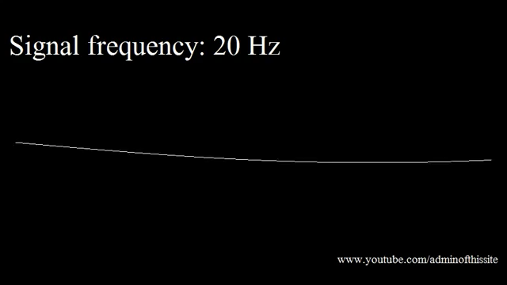
Lossy Sound – MP3
Sound
Your stupid human ears can hear sounds from 20Hz to 20,000Hz
But as you get older, you lose the ability to hear. So there is no point having frequencies inside your sound file that ‘most’ humans cannot hear.
Test your hearing, it is playing, I can start hearing it around 120Hz. It lasts for around 2 minutes.

Slide 14


Lossy Image
Your stupid human eyes cannot see all the colours and shades of colour that could be in an image. It also cannot tell fine detail. Which one of these is lossy?

Slide 15
Lossy Image
ORIGINAL
LOSSY

Slide 16
ORIGINAL
LOSSY

Slide 17
Lossy Image
Okay, so you cannot see the difference between original and lossy image unless you zoom in…. But even though my example of the guitar girl is fine, I don’t want to lie to you.
The original image was a JPEG image.
You’ve all seen JPEG images, but JPEG images have already been compressed.
A real, 100%, pure image, with nothing removed is called a RAW image.
A JPEG image takes a RAW image, looks at the the data your stupid human eyes cannot see (or cannot see well) and removes it

Slide 18
RAW vs JPEG
You see the sky in JPEG, looks rubbish…. But this image is also a lie, because if you did a lot of lossy compression then yes the sky could look like this but no one would do this.

Slide 19
RAW vs JPEG

Slide 20
RAW vs JPEG
So, with this guy, why does the RAW file look duller?
Because RAW has all the information. It kept everything. It means it includes all the light data AND the dark data.
RAW usually looks worse to our human eyes because we are used to JPEG. So why do we use RAW? We use it because we want to have 100% of the data and when we use photoshop we can play with 100% of the data

Slide 21
Video - Lossy
Now a video is just one picture shown after another after another after another, so the compression is the same.
(Okay, this is a lie, there are 3 ways that a video does compression…but its not on your syllabus, but I’ll add to the end of this PPT)

Slide 22
Lossless
Keeps 100% of the information
Less free space than lossy after compression
Better quality

Slide 23
Where you use lossless?
You use lossless wherever you must keep all of the data.
Text
Vector**
Vector images don’t have compression, because it’s built on math and coordinates, you don’t need to compress it. The quality will always be the same regardless of the size
There are many types of lossless compression:
Run Length Encoding
Huffman (not in syllabus)

Slide 24
Run length encoding
Is lossless
CCCCCCCCCCWCCCCCCCCCCPPP
Can be written as
10C 1W 10C 3P
But we don’t write the spaces as this takes space ))
10C1W10C3P

Slide 25
Run Length Encoding
You can even use RLE for images too.
Look at the top line,
You could say: White, White, White, White, White, White, White, White
Or just say W,W,W,W,W,W,W,W,
Or with RLE just say 8W
Line 2 would be: 1W 2B 1W 2B 2W
Or you can be smarter and say: 2 WBB 2W

Slide 26
Task
Draw a 8x8 grid
Shade in an image
Give to someone
They have to do the RLE on it

Slide 27
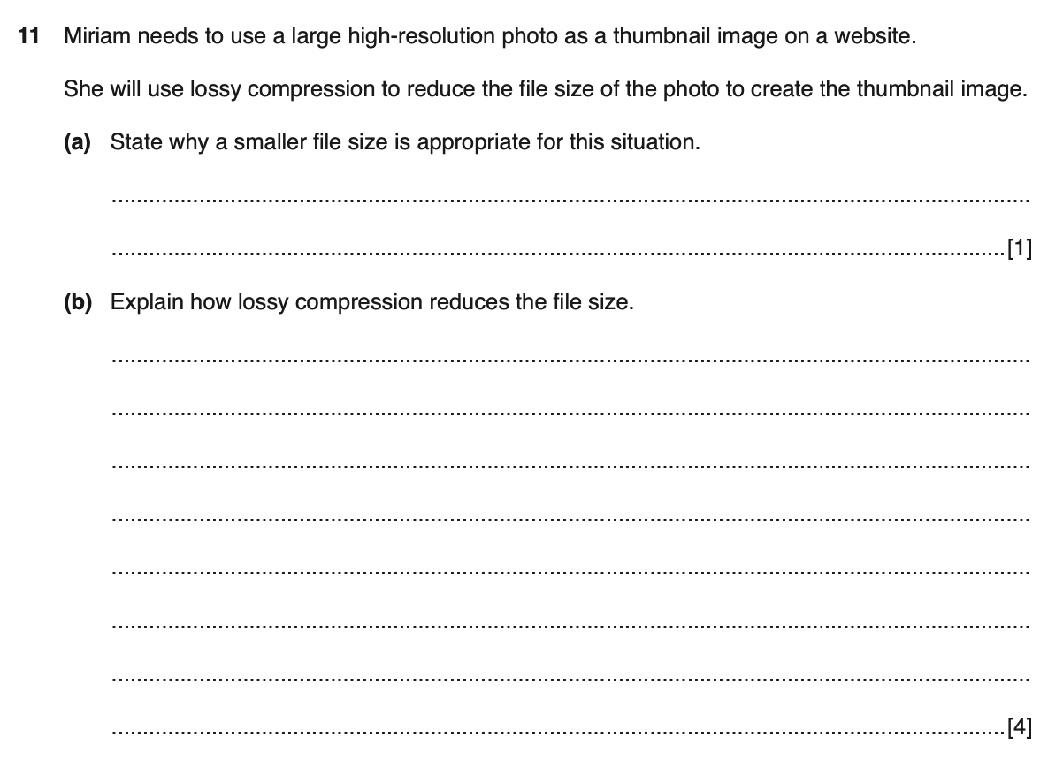
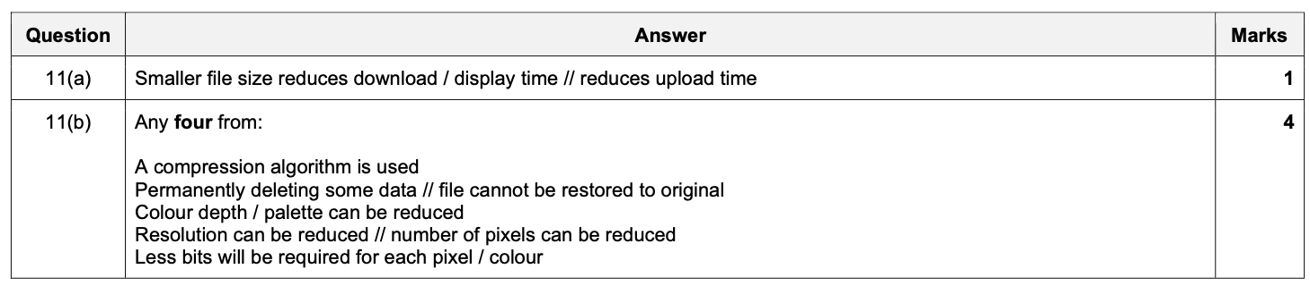

Slide 28
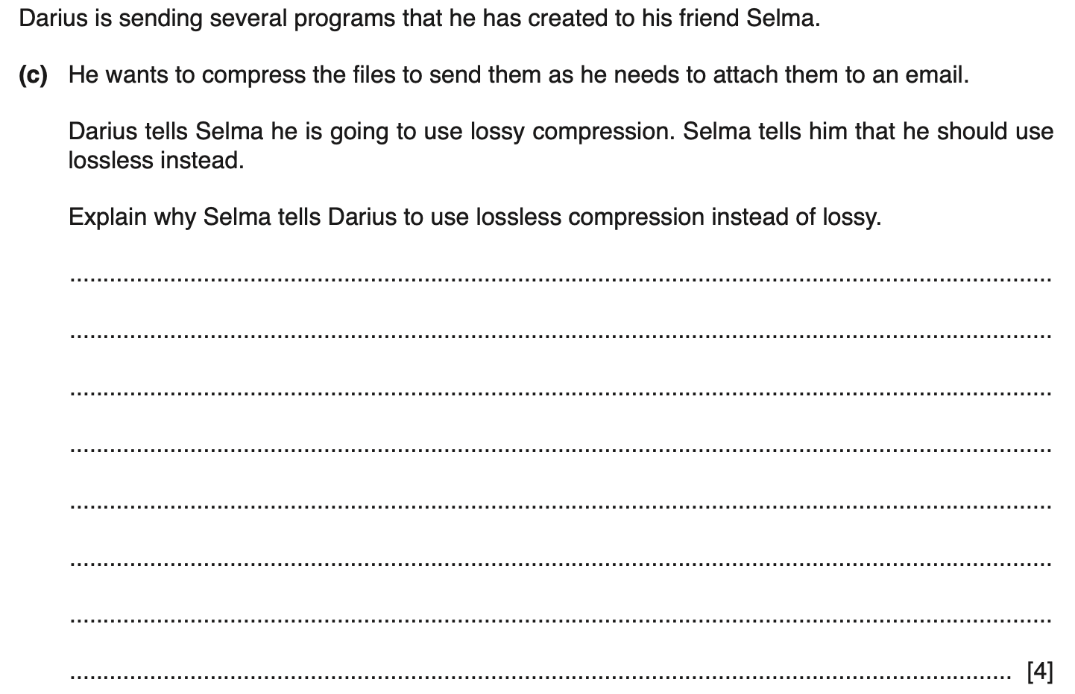
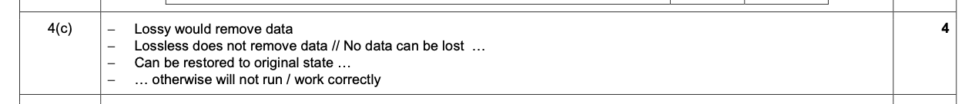

Slide 29
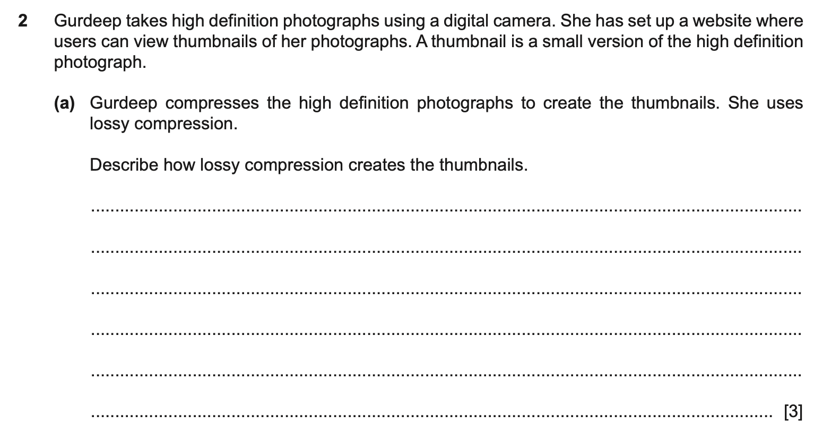
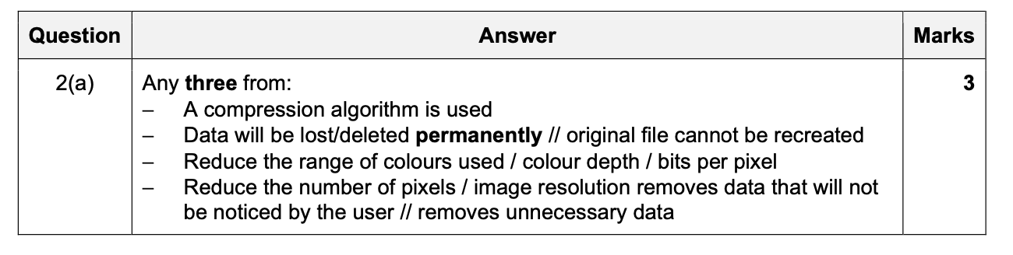

Slide 30
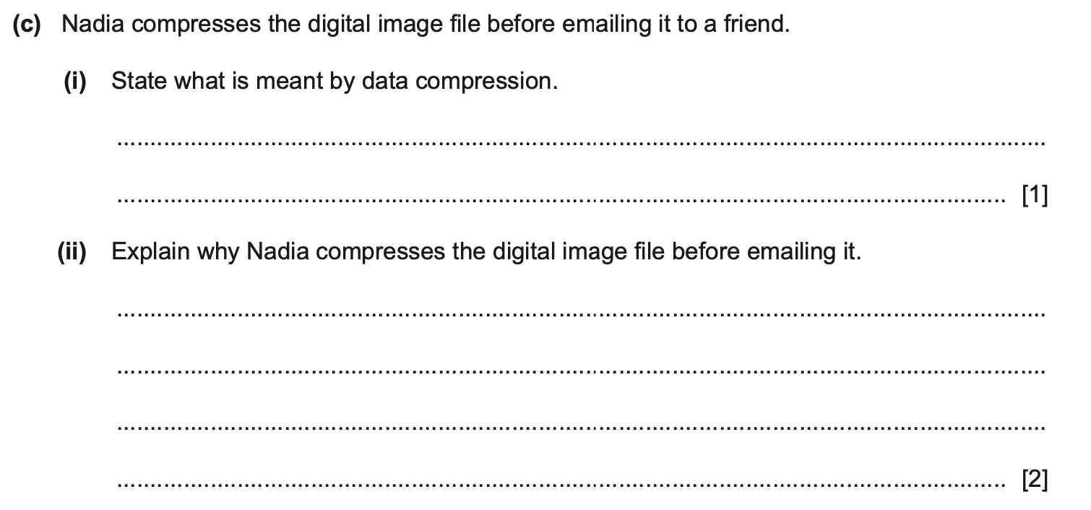
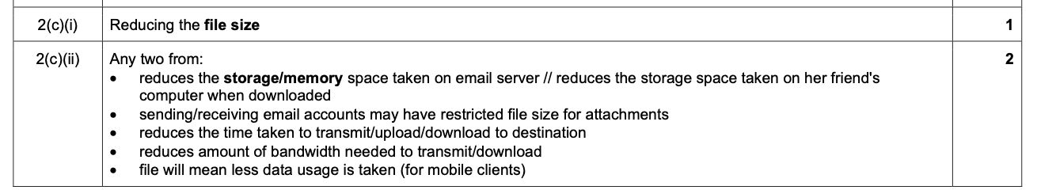

Slide 31
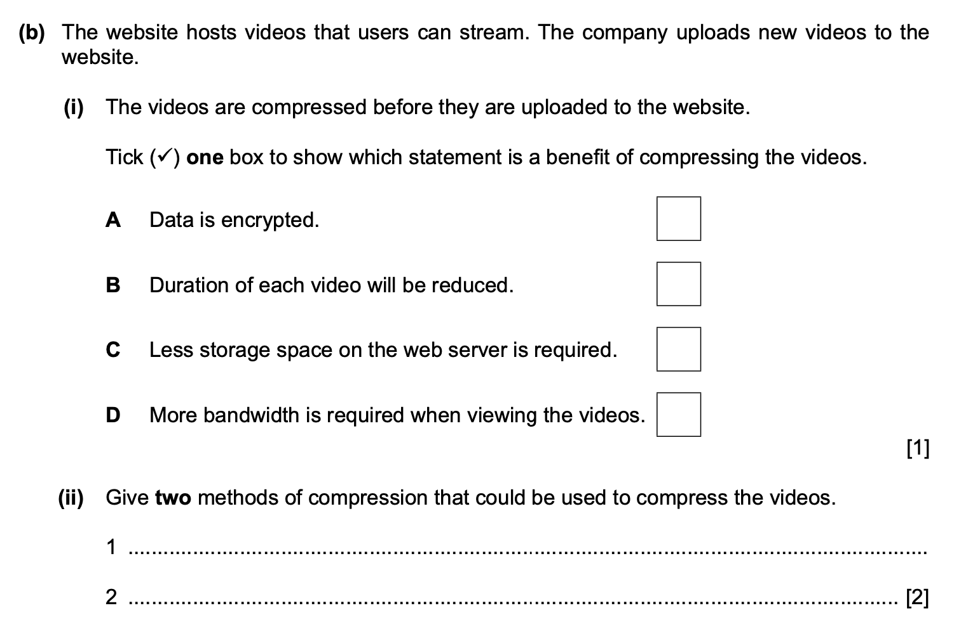

Slide 32
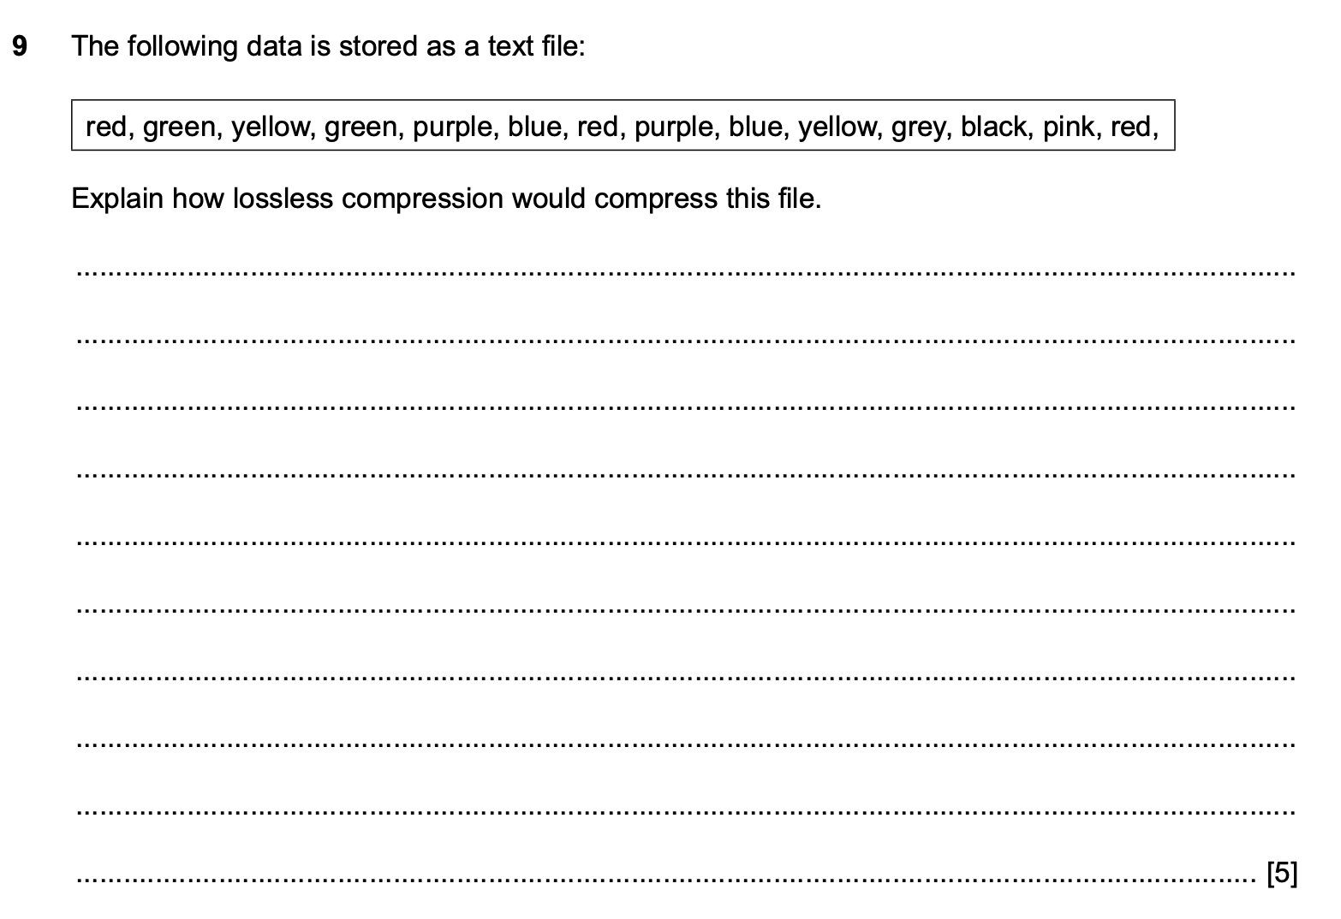
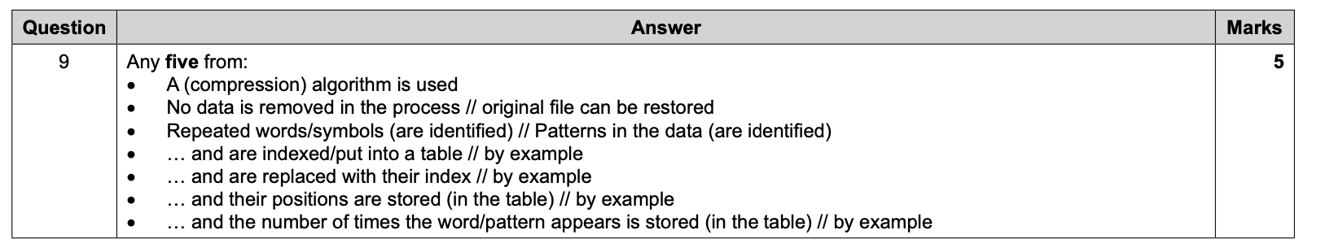

Slide 33
EXTRA FREE INFO
These next two topics are NOT in your syllabus, but are pretty cool and not so difficult.
We have:
Lossless Compression : Huffman
And
How are videos compressed

Slide 34
Huffman Coding
It’s a way to compress text.
Lossless

Slide 35
ASCII
In ASCII, every letter is either 7 bits for standard ASCII, but really everyone uses extended ASCII so we say every ASCII letter is 8 bits.
Batman’s real name is Bruce Wayne
This sentence in Binary is:
01000010 01100001 01110100 01101101 01100001 01101110 11100010 10000000 10011001 01110011 00100000 01110010 01100101 01100001 01101100 00100000 01101110 01100001 01101101 01100101 00100000 01101001 01110011 00100000 01000010 01110010 01110101 01100011 01100101 00100000 01010111 01100001 01111001 01101110 01100101
We want to make this smaller

Slide 36
How many times
Well what if we just count the number of times a letter happens (we actually also count spaces and punctuation too)

Slide 37
How many times
Letter | Frequency
a | 5
[SPACE] | 5
e | 4
n | 3
B | 2
m | 2
s | 2
r | 2
t | 1
‘ | 1
l | 1
i | 1
u | 1
c | 1
W | 1
y | 1
Batman’s real name is Bruce Wayne
So instead of using 8 bits for each letter, why don’t we say the most popular letters only uses 1 bit Then the next most popular use two bits…and so on
a = 0
[SPACE] = 1 e = 00
And there is a problem, does 00 = e or does 00 = ‘a’ twice

Slide 38
Huffman
Letter | Frequency
a | 5
[SPACE] | 5
e | 4
n | 3
B | 2
m | 2
s | 2
r | 2
t | 1
‘ | 1
l | 1
i | 1
u | 1
c | 1
W | 1
y | 1
One smart way to solve this is with Huffman encoding
You still need the frequency.
We will use this frequency to build a Binary tree,
A Huffman Tree

Slide 39
Build a tree
Letter | Frequency
a | 5
[SPACE] | 5
e | 4
n | 3
B | 2
m | 2
s | 2
r | 2
t | 1
‘ | 1
l | 1
i | 1
u | 1
c | 1
W | 1
y | 1
Take the two most least used characters
W and y
We say how many times they are used. 1 time each
W
y
1
1
W
y

Slide 40
Build a tree
Letter | Frequency
a | 5
[SPACE] | 5
e | 4
n | 3
B | 2
m | 2
s | 2
r | 2
t | 1
‘ | 1
l | 1
i | 1
u | 1
c | 1
W | 1
y | 1
Then we link these two by adding their values
Now take this and put it at the bottom of your tree
2
1
1
W
y

Slide 41
Build a tree
Letter | Frequency
a | 5
[SPACE] | 5
e | 4
n | 3
B | 2
m | 2
s | 2
r | 2
t | 1
‘ | 1
l | 1
i | 1
u | 1
c | 1
W | 1
y | 1
Then we link these two by adding their values
Now take this and put it in back in your frequency table.
2
1
1
W
y

Slide 42
Build a tree
Letter | Frequency
a | 5
[SPACE] | 5
e | 4
n | 3
B | 2
m | 2
s | 2
r | 2
2 | 1
t | 1
‘ | 1
l | 1
i | 1
u | 1
c | 1
W | 1
y | 1
Now take this and put it in back in your frequency table.
If you reach a letter (like ‘r’) that matches the sum of two frequencies (W and y) then put them all on one level
2
1
1
W
y

Slide 43
My Tree
This is what it looks like so far.
Then you just keep repeating it
2
1
1
W
y

Slide 44
START
22
11
12
10
7
8
5
5
a
SPACE
4
4
4
4
e
4
3
n
2
2
2
2
2
r
r
s
2
2
2
2
B
m
1
1
1
W
y
u
1
1
1
c
l
i
1
1
1
1
l
i
t
‘

Slide 45
So what
Now with the tree, every time you go left is a 0
Every time you go right is a 1
START
22
11
12
10
7
8
5
5
a
SPACE
e
4
4
4
4
4
3
n
2
2
2
2
2
r
r
s
2
2
2
2
B
m
1
1
1
W
y
u
1
1
1
c
l
i
1
1
1
1
l
i
t
‘

Slide 46
What’s the code?
START
So if you want ‘B’
It was 01000010
You know the frequency is 2.
You know left is 0
Right is 1
So from the top (START)
Go Right (22) - 1
Go Right (12) - 1
Go Right (8) - 1
Go Right (4) - 1
Go Left (2) - 0
So B is now 11110
22
11
12
10
7
8
a
5
SPACE
5
4
4
4
4
e
4
3
n
2
2
r
2
2
2
r
s
2
2
2
2
B
m
1
1
1
W
y
u
1
1
1
c
l
i
1
1
1
1
l
i
t
‘

Slide 47
What’s the code?
B is now 11110
What if you want a more popular letter, ‘e’
START
RIGHT (22) – 1
RIGHT (12) - 1
RIGHT (8) - 1
LEFT (e) - 0
So e is now 1110
Because e is more popular than B, it has a shorter code
START
22
11
12
10
7
8
5
5
a
SPACE
e
4
4
4
4
4
3
n
2
2
2
2
2
r
r
s
2
2
2
2
B
m
1
1
1
W
y
u
1
1
1
c
l
i
1
1
1
1
l
i
t
‘

Slide 48
+ & -
+ More popular letters use less binary bits
Takes time to make a Huffman Tree
You have to store the tree so there is a reference
± If you have a really deep/tall tree, you may have a letter that uses more than 8 bits. But this is okay because that letter will be at the bottom of the tree and those letters are not used often

Slide 49
Today
Understand : What is a video?
Able : Explain encoding
Answer : What is frame rate

Slide 50
What is a video?
What is the correct definition?
Video is a series of moving images played back at speed to imitate movement
Video is a series of moving images
Video is a series of still images
Video is a series of still images that are play backed at speed to imitate movement

Slide 51
Frames
If video is a set of images play backed at speed. How quick must it be?
Frame – This means one image.
If you have 1 image on screen for 1 second, you say your video is 1 frame per second (fps)
Most videos are 30fps and smooth videos or video games are done at 60fps.
Higher frame rate the smoother the video playback

Slide 52
Encoding
There are two main ways that a video gets displayed.
Interlaced encoding
Progressive encoding

Slide 53
Interlaced
It shows an image in two frames
Splits image into rows
Displays the odd number rows in the first frame
Then displays even number rows in the second
Happens so quick you think it’s a single frame

Slide 54
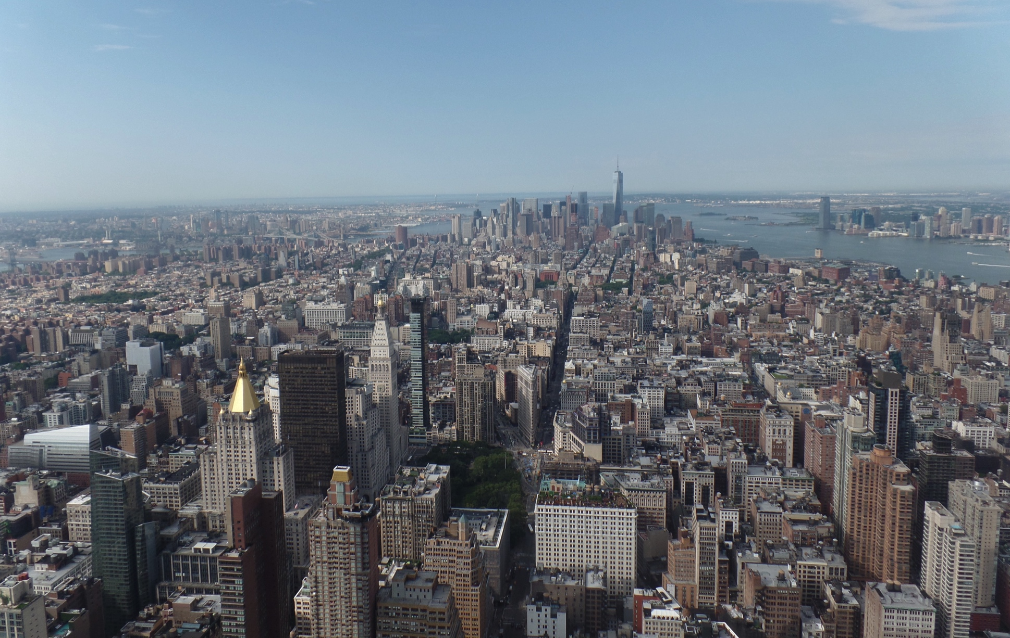
Interlaced – Takes a frame

Slide 55
Interlaced – Splits it

Slide 56
First frame– Displays odd sections

Slide 57
Second frame– Displays even sections

Slide 58
Interlaced

Slide 59
Why?
Cheaper on bandwidth to send part of a frame then the whole frame
Older technology (before progressive)
Broadcast TV uses interlaced – because its cheaper (both hardware is cheaper and bandwidth cost)

Slide 60
Progressive
Displays whole frame at once

Slide 61
Progressive

Slide 62
Why?
Better quality – less ‘noise’ / artifacts than interlaced
Hardware has gotten better

Slide 63
Find out what are:
Image artifacts
Moiré effect

Slide 64
Today
Understand : What is interframe compression
Able : Understand the difference between Spatial and temporal redundancy
Answer : Why we use compression

Slide 65
Interframe Compression
Videos are big sizes
So you need to compress the video to make it smaller
But how??

Slide 66
Interframe compression - i-frame
It starts with an i-frame
An i frame is your full frame – it must be the first frame in your video and you can have many i-frames in your video

Slide 67
Interframe – P Frame
The next frame of your video is broken up into 8x8 blocks called MACRO BLOCKS
If the Macro block from frame 2 is the same or similar as frame 1 then we will put in a P-frame (predicted frame)
A P frame looks at an i-frame and says “you look almost the same” instead of processing the whole thing I’ll just process the changes”
This includes colour changes, size, movement

Slide 68
Interframe – B Frame
An I-frame is fixed,
A P frame looks at an i-frame
A B frame (bidirectional) looks at both an i-frame and p frame

Slide 69
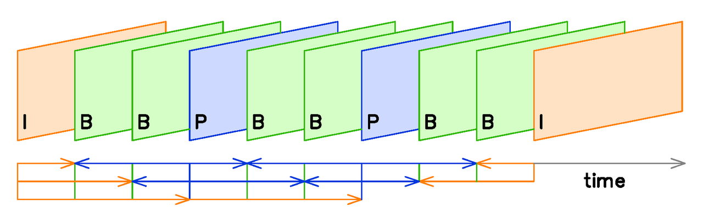
The format of it IBBPBBPBBI

Slide 70
Spatial Redundancy
Just like when you compress an image (like a JPEG)
It only happens on a single frame (usually i-frames)
It looks at your frame and removes data that you cannot see / notice the difference (much)

Slide 71
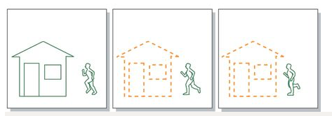
Temporal Redundancy
If parts of your video don’t change then an instruction is given to say “hey, don’t change this part”
So in this example the house doesn't’t change.
It is used in P-frames
They use half as much data as an i-frame

